Slide 1
Data Format

Slide 2
Common computer data formats used with the Intel family of microprocessors are ASCII, Unicode, BCD, signed and unsigned integers, and floating-point numbers (real numbers).
ASCII (American Standard Code for Information Interchange) data represent alphanumeric characters in the memory of a computer system.
The standard ASCII code is a 7-bit code, with the eighth and most significant bit used to hold parity in some antiquated systems.
If ASCII data are used with a printer, the most significant bits are a 0 for alphanumeric printing and 1 for graphics printing.
an extended ASCII character set is selected by placing a 1 in the leftmost bit
The extended ASCII characters store some foreign letters and punctuation, Greek, characters, mathematical characters, box-drawing characters, and other special characters.

Slide 3
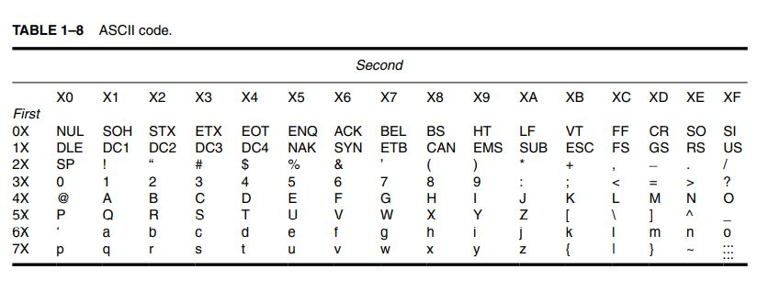
ASCII Code

Slide 4
locate the alphanumeric code for conversion
find the first digit of the hexadecimal ASCII code
find the second digit
For example, the capital letter “A” is ASCII code 41H, and the lowercase letter “a” is ASCII code 61H.
locate the alphanumeric code for conversion
find the first digit of the hexadecimal ASCII code
find the second digit
For example, the capital letter “A” is ASCII code 41H, and the lowercase letter “a” is ASCII code 61H.

Slide 5
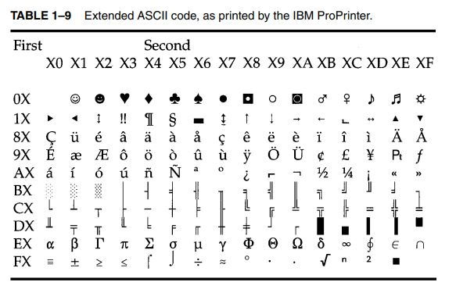

Slide 6
Many Windows-based applications, since Windows 95, use the Unicode system to store alphanumeric data.
stores each character as 16-bit data
The codes 0000H–00FFH are the same as standard ASCII code.
The remaining codes, 0100H–FFFFH, are used to store all special characters from many worldwide character sets.
This allows software written for the Windows environment to be used in many countries around the world.

Slide 7
ASCII data are most often stored in memory by using a special directive to the assembler program called define byte(s), or DB.
The assembler is a program that is used to program a computer in its native binary machine language.
An alternative to DB is the word BYTE.

Slide 8
each character string is surrounded by apostrophes (’)—never use the quote (”)
Also notice that the assembler lists the ASCII-coded value for each character to the left of the character string.
To the far left is the hexadecimal memory location where the character string is first stored in the memory system.
For example, the character string WHAT is stored beginning at memory address 001D, and the first letter is stored as 57 (W), followed by 68 (H), and so forth.

Slide 9
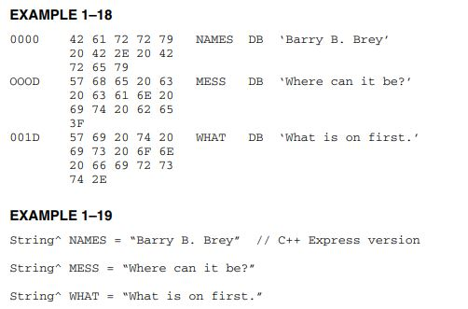

Slide 10
BCD Binary Coded Decimal Data
Binary-coded decimal (BCD) information is stored in either packed or unpacked forms.
Packed BCD data are stored as two digits per byte and unpacked BCD data are stored as one digit per byte.
The range of a BCD digit extends from 00002 to 10012, or 0–9 decimal.
Unpacked BCD data are returned from a keypad or keyboard.
Packed BCD data are used for some of the instructions included for BCD addition and subtraction in the instruction set of the microprocessor.
If a system requires complex arithmetic, BCD data are seldom used because there is no simple and efficient method of performing complex BCD arithmetic.

Slide 11
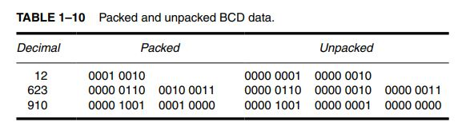

Slide 12
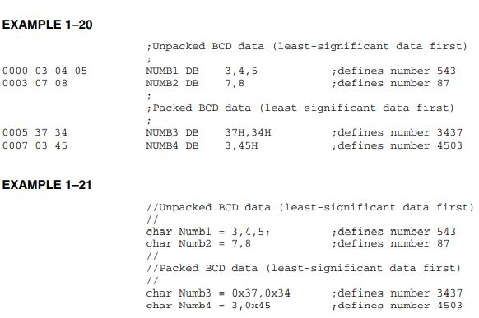

Slide 13
Byte-sized data
Byte-sized data are stored as unsigned and signed integers.
Figure 1–14 illustrates both the unsigned and signed forms of the byte-sized integer.
The difference in these forms is the weight of the leftmost bit position.
Its value is 128 for the unsigned integer and minus 128 for the signed integer.
In the signed integer format, the leftmost bit represents the sign bit of the number, as well as a weight of minus 128.
For example, 80H represents a value of 128 as an unsigned number; as a signed number, it represents a value of minus 128.
Unsigned integers range in value from 00H to FFH (0–255). Signed integers range in value from -128 to 0 to + 127.

Slide 14
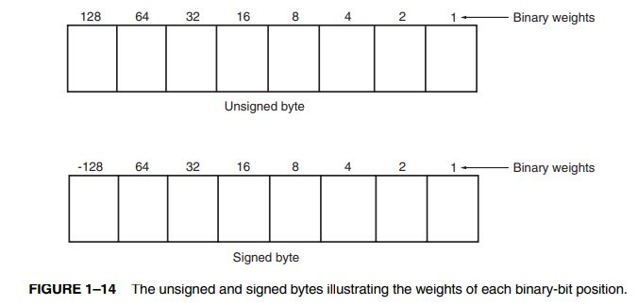

Slide 15
Whenever a number is two’s complemented, its sign changes from negative to positive or positive to negative.
For example, the number 00001000 is a +8.
Its negative value (-8) is found by two’s complementing the +8.
To form a two’s complement, first one’s complement the number.
To one’s complement a number, invert each bit of a number from zero to one or from one to zero.
Once the one’s complement is formed, the two’s complement is found by adding a one to the one’s complement.

Slide 16
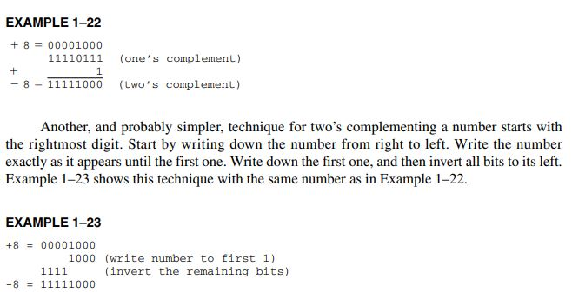

Slide 17
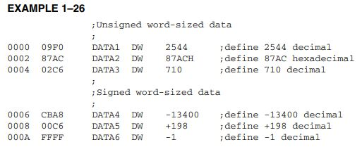
Byte Sized Data

Slide 18
Word Sized Data
A word (16-bits) is formed with two bytes of data.
The least significant byte is always stored in the lowest-numbered memory location, and the most significant byte is stored in the highest.
This method of storing a number is called the little endian format.
An alternate method, not used with the Intel family of microprocessors, is called the big endian format.
In the big endian format, numbers are stored with the lowest location containing the most significant data.
The big endian format is used with the Motorola family of microprocessors.

Slide 19
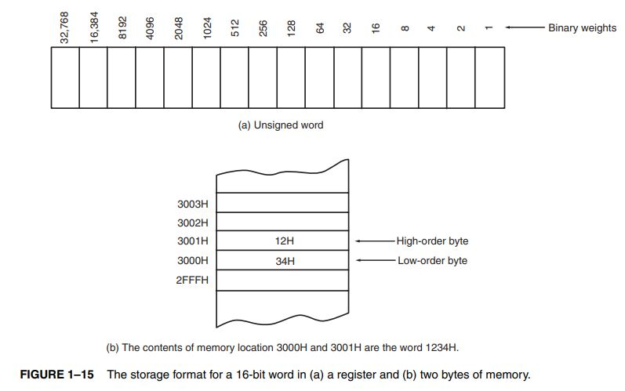

Slide 21
Doubleword-sized data
Doubleword-sized data requires four bytes of memory because it is a 32-bit number.
Doubleword data appear as a product after a multiplication and also as a dividend before a division.
In the 80386 through the Core2, memory and registers are also 32 bits in width.

Slide 22
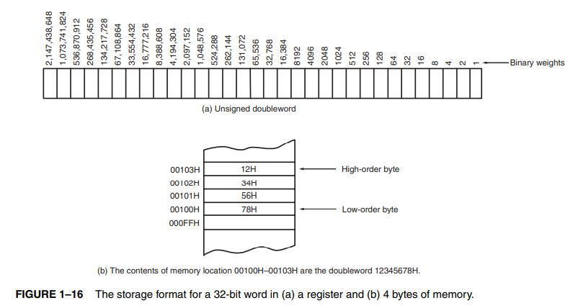

Slide 23
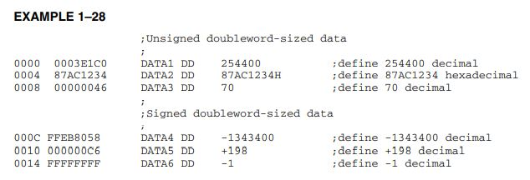

Slide 24
Real Numbers
A real number, or a floating-point number, as it is often called, contains two parts: a mantissa, significand, or fraction; and an exponent.
the 4-byte number is called single-precision and the 8-byte form is called double-precision
the single-precision form that contains a sign-bit, an 8-bit exponent, and a 24-bit fraction (mantissa)

Slide 25
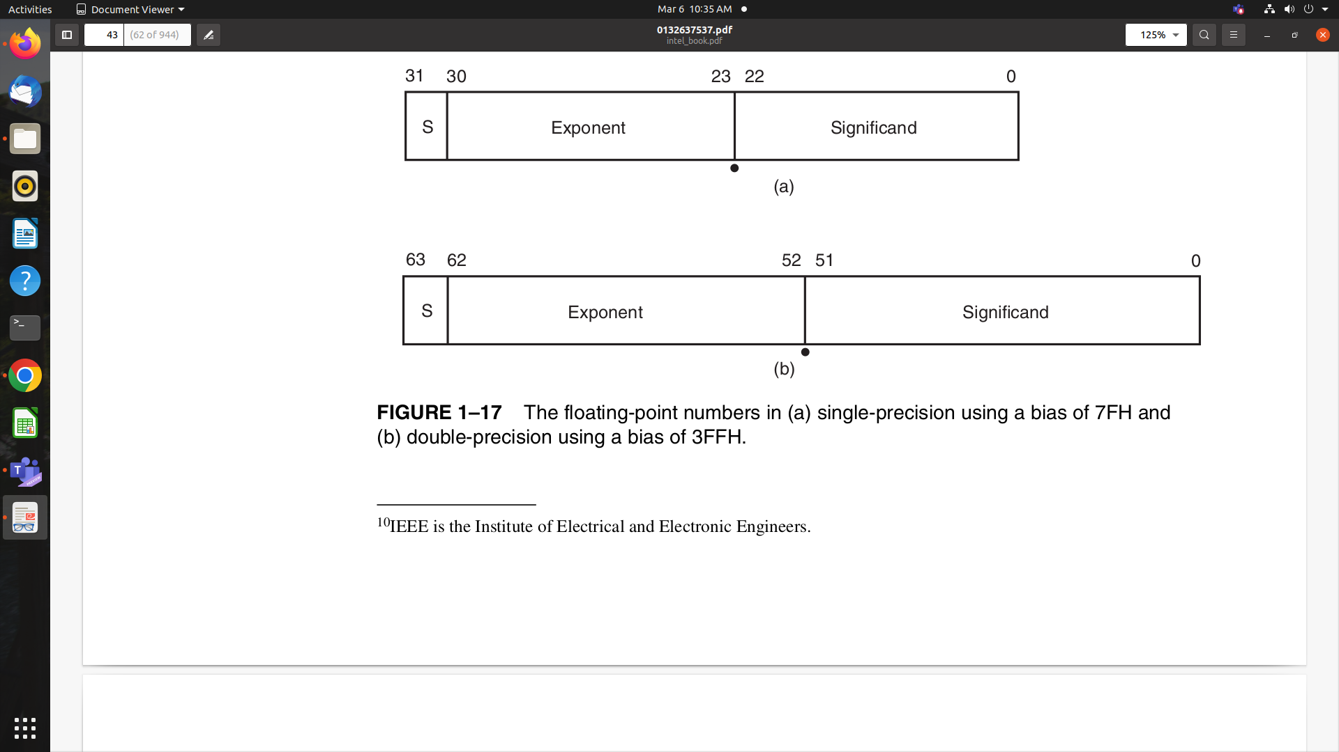

Slide 26
